Slide 1
Mid-term Review
Mid-term will occur in class on 10/15/2018.
One page note( front and back) is permitted.
Closed book
Total time is 75 minutes
Questions includes:
  10 short-answer questions
  10 True/False questions
  10 Multiple-choice questions
  3 Long-answer questions
1

Slide 2
Midterm Review
What’s Internet, protocol?
Network Edge
  Access networks, physical media
  How to connect end systems to edge routers?
  Host sending function
Network Core
  Packet-switching: Store and forward; end-end delay; queuing and loss;
  Circuit switching: TDM vs FDM; Example.
Internet structure

Slide 3
Midterm Review
Packet delay
  Four sources of packet delay;
Packet loss
Throughput
Protocol layer
  Internet protocol stack
  ISO/OSI reference mode
Encapsulation

Slide 4
Midterm Review
Network security
  Malware: virus and worm
  DoS
  Packet sniffing
  IP spoofing
Chapter 2
Application models
  Client-server
  peer-to-peer (P2P)
Socket

Slide 5
Midterm Review
Transport protocols
  TCP
  UDP
Web and HTTP
  HTTP protocol
  Persistence and non-persistence HTTP
  RTT
  HTTP response time
  HTTP response message (see example)
  Cookies
  Web caches
  Conditional GET

Slide 6
Midterm Review
Electronic mail
  Three major components
  SMTP
  Mail access protocols (POP3, IMAP, HTTP)
  SMTP vs HTTP

Slide 7
Midterm Review
DNS
  Definition
  Services
  Different Tiers of servers
  DNS resolution example
  DNS records (resource records (RR))
  DNS for HTTP
P2P
  Example about file distribution using CS vs P2P
  BitTorrent

Slide 8
Midterm Review
Video Steaming
  DASH: server and client
  Content distribution networks
Socket programing
  UDP and TCP
  Application example

Slide 9
Midterm Review
  Part1: 10 Short-answer questions (carefully, briefly and clearly. )
  Please give the names of the seven layers of ISO/OSI reference model.
  What is the main reason that packet loss may occur in computer network?

Slide 10
Midterm Review
  Part 2: 10 True/False questions. If false, please give the correct answer.
  Packet switching is dedicated, while circuit switching is not.

Slide 11
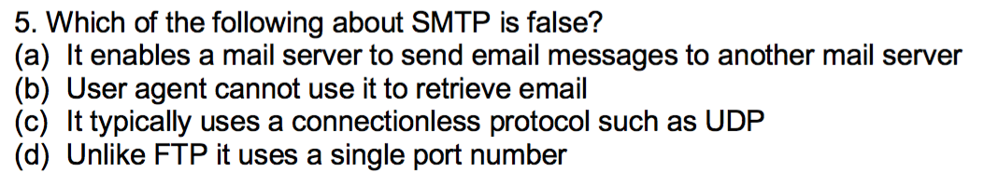
Midterm Review
  Part 3: 10 Multiple-choice questions (Single answer), please circle it.

Slide 12
Midterm Review
  Part 4: 4 Long-answer questions
  1. Please fill the following blanks in python code for the implementation of the TCP or UDP server/client,

Slide 13
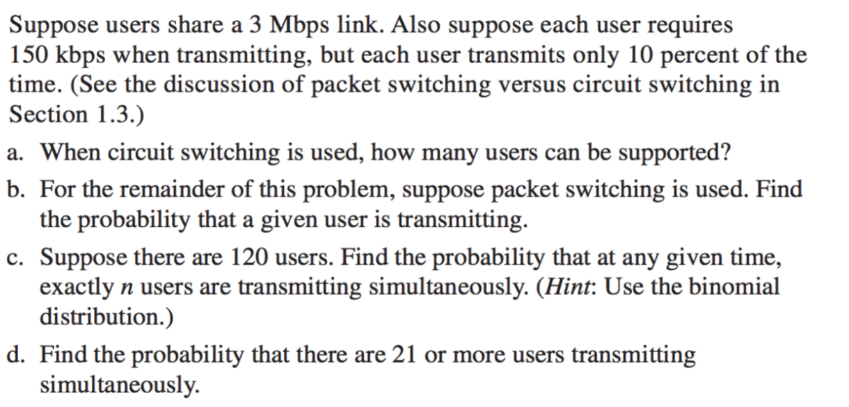
Midterm Review
  Part 4: Long-answer questions

Slide 14
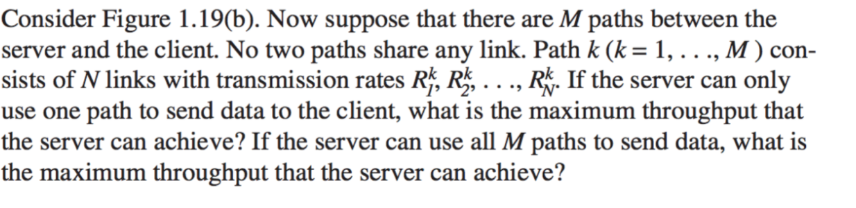
Midterm Review
  Part 4: Long-answer questions

Slide 15
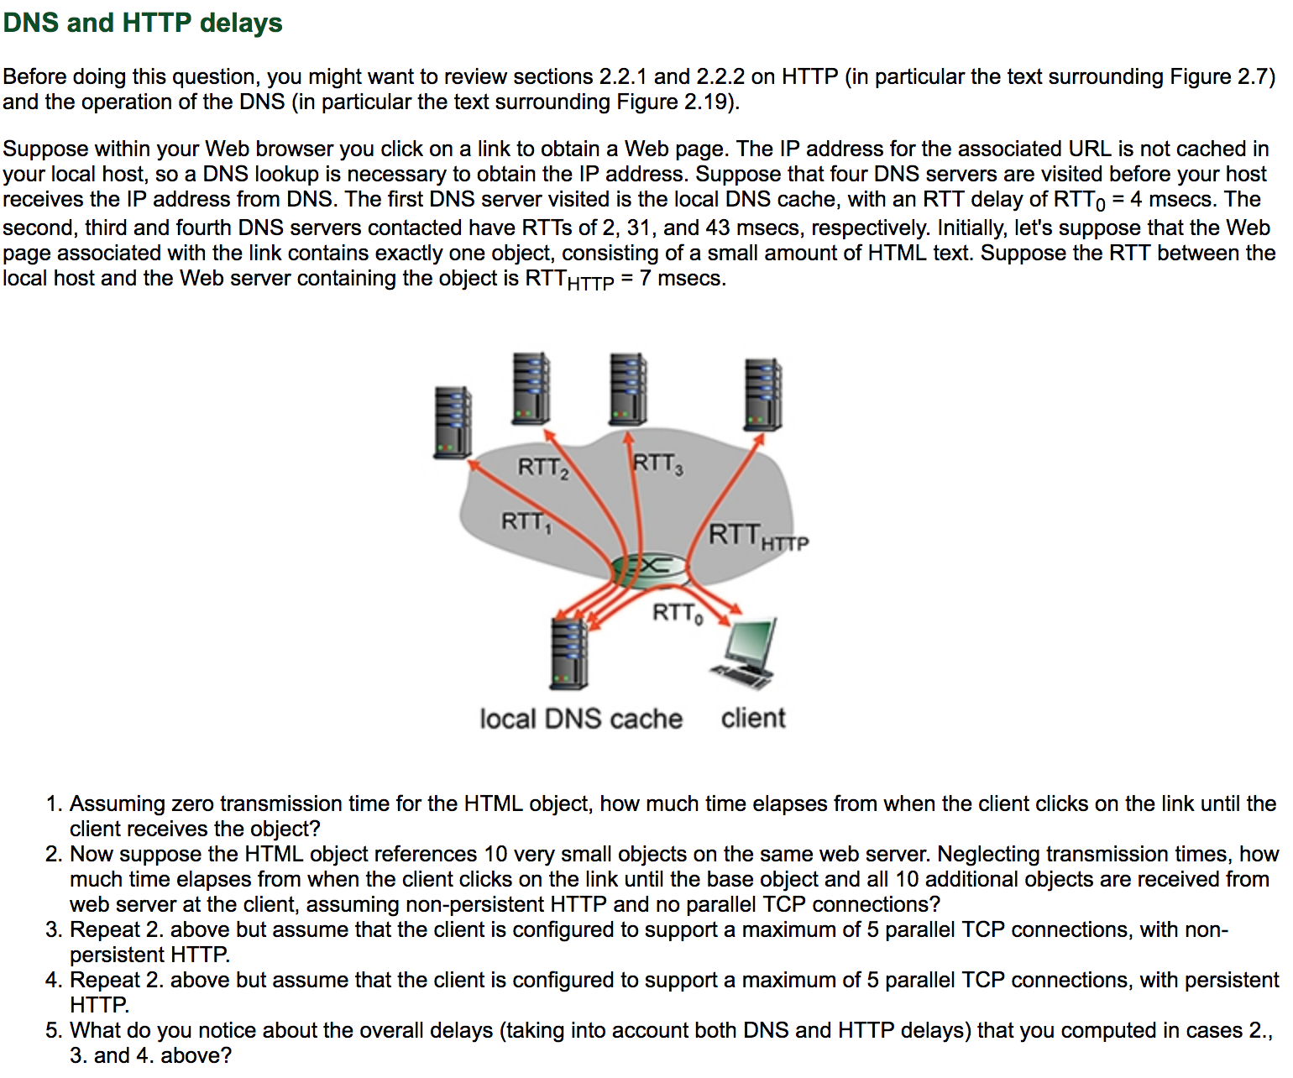
Application Layer
2-<number>

